Slide 1
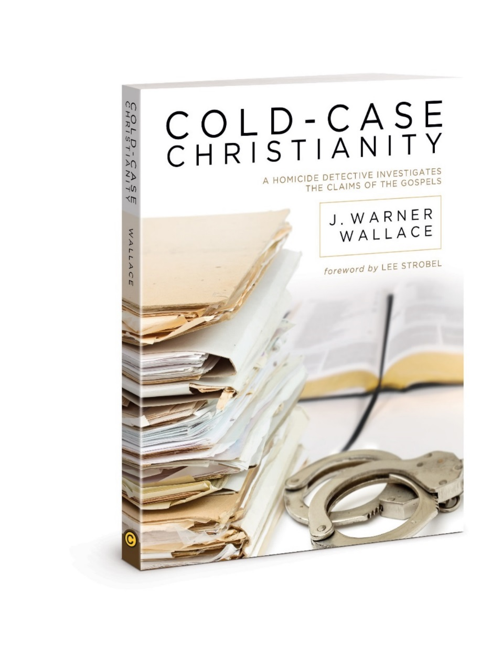
Chapter 9
Know when Enough is Enough

Slide 2

Winston Churchill
“Men stumble over the truth from time to time, but most pick themselves up and hurry off as if nothing happened.”

Slide 3
Ancient History
Without a video live stream of Jesus’ tomb
You couldn’t say 100% what happened
But we came across the most reasonable inference for the evidence
The early church and actions of the apostles are best explained by a resurrected Jesus

Slide 4
You can’t know for sure
Is an argument folks will make with regards to the resurrection
Even though there is no other world religion with miracles reported by their founder within the first generation – Habermas
It’s easy to smell a rotten egg, but harder to lay a new one

Slide 5
People in our culture make decisions that they do not have 100% certainty about every day

Slide 6
A legal system is needed for any modern society in order to prevent unrestrained anarchy
How does ours determine when enough information has been provided to make a decision?

Slide 7
Levels of legal “standard of proof” our legal system
1.)Some Credible Evidence: lowest possible standard, often used in cases involving child protection in that there is a suspicion a child is at risk of abuse.
2.)Preponderance of the Evidence: a proposition is more likely to be true than untrue by at least 51%

Slide 8
Levels of legal “standard of proof”
3.)Clear and Convincing Evidence: a proposition is significantly and substantially more likely to be true than untrue.
4.)Beyond a Reasonable Doubt:
Highest level of proof required by law, where there is no explainable reason to believe that a proposition is untrue.

Slide 9
Job of a jury
Jurors are asked to make a decision in the present based on evidence from the past, to impact the future.
Either the evidence is sufficient today or it is not. Not based on what evidence might show up later.
As a juror, you do not get the option to remain ‘agnostic’. Either the evidence is enough or not.

Slide 10
Even with very strong evidence
People can reject a truth claim for rational doubts based on the evidence, emotions, or out of volition, meaning they will not listen to what the other side has to say no matter what.
There is never a court case where the evidence is exhaustive.

Slide 11
Can non-perfect evidence be trusted?
No worldview has ‘perfect’ evidence
We all make decisions every day with less-than-perfect knowledge and missing information.
ie.)you assume your car didn’t have a pipe bomb rigged to the ignition. Brakes worked?
Most don’t understand how cars work, yet they use them daily.
We trust humans to tell the truth even though we can’t read their minds.

Slide 12
Non-Perfect evidence
Juries reach verdicts beyond a reasonable doubt every day even with some unanswered questions or pieces to the puzzle because the reasonable evidence they have is greater than the possible questions that are unanswered

Slide 13
Final thoughts
Our objections and doubts should be rational; not emotional or volitional.
Don't be surprised when your well reasoned arguments land on deaf ears if the particular evidence you pose is not considered that important to the person you are talking to.
If you ask any Christian when and why they decided to follow Jesus, you'll see different pieces of evidence that stood out to them the most.

Slide 14
Francis Bacon quote
Man prefers to believe what he prefers to be true

Slide 15
Philosophical Naturalism
If someone tells you miracles are impossible
Gary Habermas points folks to modern documented NDE cases and miracles
30 million claimed NDE cases in NA and Europe alone
If just one of those are true, naturalism is false
And “anything is more reasonable than a resurrection” turns into. If there is consciousness after death, maybe I should look into this resurrection claim more closely.
Notes:
NDE – Near Death Experiences: at least 15 seconds with no brain or heart activity
-
NDE in rarer cases, people have seen and heard things that they couldn’t possibly have observed without brain activity in our world
-
NDEs are not evidence for Christianity, but rather that there is conscience and the ability to think even without neurological function
-
If people tell you that Christians are crazy people who believe in Narnia, Middle Earth, and the land of Oz, tell them to look into NDE research, where apparently people are seeing things that don’t exist in our universe.

Slide 16
Chapter 16
Becoming a “two-decision” Christian
Notes:
For these next 4 chapters, we are going into the evidence

Slide 17
2nd decision?
Author gives scenario
Crack addict robbed several banks
Had made a decision to trust Jesus for salvation
But not evidentially (the 2nd decision)
Reduced his beliefs to just mere opinion
Hard for life to reflect something we don’t believe
Notes:
1.)scenario – Crack addict robbed several Los Angeles banks and Jim arrested him
3.)He said he made a decision for Christ at a Christian crusade event where he said he decided to trust Jesus for salvation
5.)He was unable to see his beliefs past mere subjective opinions after having been battered with the skepticism of the world against his trust in Jesus
6.)Further, it is harder to share what we know about Jesus if we feel our claims will be met with claims from the world, such as “you can’t possibly know if that’s true”, or “that’s just a made-up religion”

Slide 18
Christian Case Makers
Many do not think they can do it
Have to be an expert?
Jurors – not experts. Relied upon every day
Eph 4:11-12 – not all called to be Billy Grahams
Pet 3:15 – be prepared to give an answer
Ever felt unprepared?
Notes:
Many → A Christian case maker is able to make an evidential case for Christ
Have → Do you have to be an expert to defend what you believe?
Jurors → are ordinary people across our country who are ordinary people like you and me. They are not experts, but are relied upon to evaluate the evidence to draw the most reasonable inference.
Eph → Ephesians 4:11-12 – “He Himself gave some to be apostles, some prophets, some evangelists, and some pastors and teachers for the equipping of the saints…”
Pet → tells us it is our duty to "be prepared to give an answer to everyone who asks us to give the reason for the hope that we have"

Slide 19
Can’t Do It?
Professional chefs
Don’t have to be pro to make a meal
Ours not as flavorful and creative
But can be as powerful and persuasive
If we believe the Gospels,
Make the 2nd decision to a Christian Case Maker
Devote yourself to the truth
Notes:
Professional → We all know about chefs on TV and around the world who have extreme talent
Ours → Our Christian case making might not be as flavorful and creative as the top Christian Apologists, but can still be just as powerful and persuasive
Devote → yourself to the truth; someone’s life depends on it.

Slide 20
for more information visit:
www.ColdCaseChristianity.com

